Slide 1
Garments
Management System
Student ID:
1405072
1405075
1405079
1405086
1405087

Slide 2
Why is the system required?
More than 5000 factories
4 million workers
$26 billion a-year industry
Source: http://www.huffingtonpost.com/entry/bangladesh-garment-industry-trembles_us_5777eddee4b0a629c1aa4e89

Slide 3
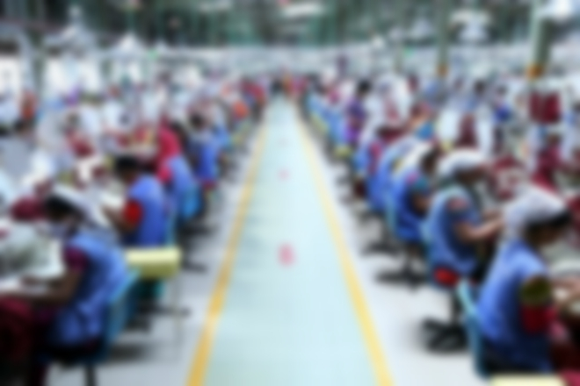
But,
Very few management system software available.

Slide 4
Garment System in Bangladesh
Foreign buyers give orders to the garments.
The garment management receives the order.
Management distributes the work to it’s employees.
After the completion of work, Tester checks the work.
Finally shipment (delivery) is done.
We want to develop the software for this system according to this logical design.

Slide 5
The Management System Branches
Board of Directors
Clients
Employees
Orders
Suppliers
Materials
Services
What we are working with

Slide 6

Our System
Delivery System Managing the shipment of the products and materials.
Employee Management With all the information of an employee in the database, the system will operate on the financial and human resource section.
Everything on a Database Everything will be registered into the system.
Buyer-Owner Interactions Our system will make it easier for owners to do business.
Product Ordering Each of the order placed will be dynamically monitored and maintained by the system.

Slide 7

Our System (Continued)
Supplies Monitoring System checks everything related to material supplies and service supplies.
Saving Finance Information Our system will have a section for the owners to manage the economic side. It will feature the billings, tax payments, loans etc.
Services Every utility service used by a garment factory will be managed by the system. Like Security Services, Machinery Services etc.
Order Progress Tracking The orders that are in place will be tracked and checked. Our system will monitor the current states of every orders.

Slide 8
Online Money Transaction The System will not handle any kind of transaction.
Financial Decisions The system will hold financial records and statistics. But it will not calculate the financial facts.
Stock Market Analysis We will not include stock market transactions, stock values etc.
What is not included

Slide 9
Let’s make the Garment Industry of Bangladesh great (and digital) again!
Thank You.

